Slide 1
ALHRM
Human Resource Management

Slide 2
Agenda
Overview
ALHRM Rollout
Training/Support
Q&A

Slide 3
Introduction
The new ALHRM Human Resource Management System was developed as a result of a multi-year effort to assess and ensure a smooth transition from GHRS.
GHRS
ALHRM

Slide 4
Overview
Modern web-based solution that is streamlined and intuitive for the end user
User’s business roles determined by security level
Enhanced ability to search for crucial information
Guides and Help available from the Global Navigation bar
Configurable Page & Grid Layouts
Notes:
ALHRM is a modern solution that is built off the latest available technologies and incorporates a web-based solution that is streamlined and intuitive for the end user.
Simple, clean user experience that progressively presents data to the user
Intuitive data arrangement/structure throughout the system – as the user works through the tabs it progresses through and provides the specific information needed at each point and it uses the information to build the end result (ex – Employee Profile Management Folder – Employee Status Maintenance, Employee Activity Pay Parameter, Attributes, Emergency Contact, Address, etc.).
Advantage ALHRM solution provides the ability to tailor the application based on the user’s business roles; presents workflow, data, and analytics tailored for a member’s specific role on a single, easy-to-navigate screen.
One User can have one to many business roles; users can tailor the application based on the business roles that they have been assigned.
Business Roles are the organization of data, the fields users see, and how users navigate and access data.
The business roles will drive the presentation and experience of the user and the defining of the roles and business processes are configuration items.
Roles drive the Homepage that the users see, the Primary (Left Hand) Navigation, the Business Processes flow, the look and feel of the pages the user has access to.
Enhanced Opportunities to extract data in a user-friendly format and the ability to search for crucial information needed to complete one’s role/ responsibility
Single Search field available that will be leveraged to pull information that is visible to the User (based on their Security Role) – use for navigation.
System is more intuitive for members who are not *experts*; for example, a page code is not needed (they can still be used but for a member who may not be as familiar they can search on Employee and they will see everything related to Employee to be able to navigate; if they were looking for Employee Attributes that would then be returned and they can select it – for an *expert* user they can still type in ATTR)
Users can create “on demand” extract; ad hoc inquiries can be executed, and data extracted for review in a .csv format.
ALHRM solution provides real time support/ assistance directly in the application; User-Guides, System Administration Guides and Page Help are available for ALHRM users
Documentation is available for reference at any time; user can select Page Help and it will include specific assistance for a field that a user is accessing, ability to access the User-Guide (features/ functions in the application that can be leveraged by the User), ability to access the System Administration Guide that is more focused on setup (ex-System Administrator who will set up Security Roles, etc.)
Configurable Page & Grid Layouts for Users
Each User will have the ability to make updates to Pages that include Grid Layouts so that the information focuses on the role/ job that they need to complete – it will be representative of what the member needs to be able to see to focus on the work that they need to complete.
Example:
Time Catalog – the Grid in the solution includes Employee ID, Appt ID, Firstname, Lastname, Transaction Code and ID
User may want additional information – the user will select the Grid icon and add additional column – example Home Dept/ Unit; Comments; can also remove items in this case that may have been part of the initial delivery that the User does not want to see.
Gear icon is used to make the adjustments

Slide 5
Personnel Overview
Tracks time and leave
Automation of leave payouts
Automation of leave balance resets
Enhanced transfer process
Timesheet adjustments will be processed on one document (TADJ vs CPERS/PPERS)

Slide 6
Payroll Overview
Standardized W-2 processing
Supports comprehensive accounting distribution
Automation of payments and deductions
Provision for itemized check stubs
Concession for two employee direct deposit accounts
Capacity for longer retention history for paystubs and leave detail

Slide 7
Payroll Overview
Payroll will no longer be processed with the Payroll Accounting JV (JVPR1i)
Agencies can now edit their own Payroll Expenditure (PREXP)
Can now charge out to over 30+ accounting elements
Reduced dependency on payroll accounting templates
Seamless integration between ALHRM and STAARS Financial

Slide 8
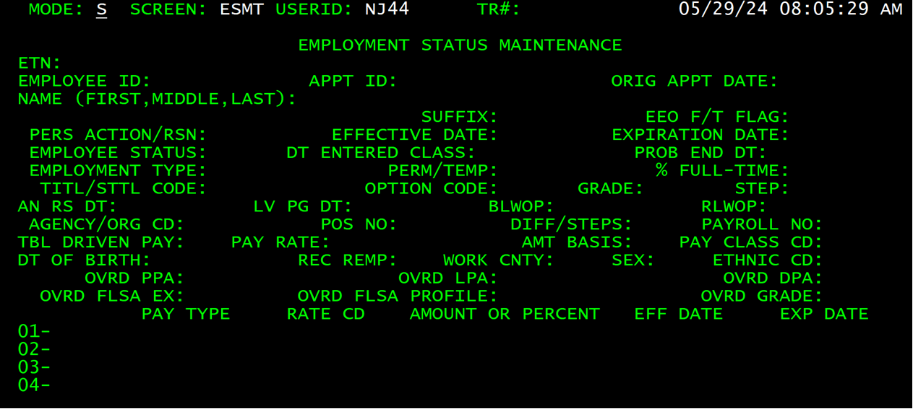
Overview
ESMT in GHRS
Notes:
This is the ESMT screen you use today in GHRS.

Slide 9
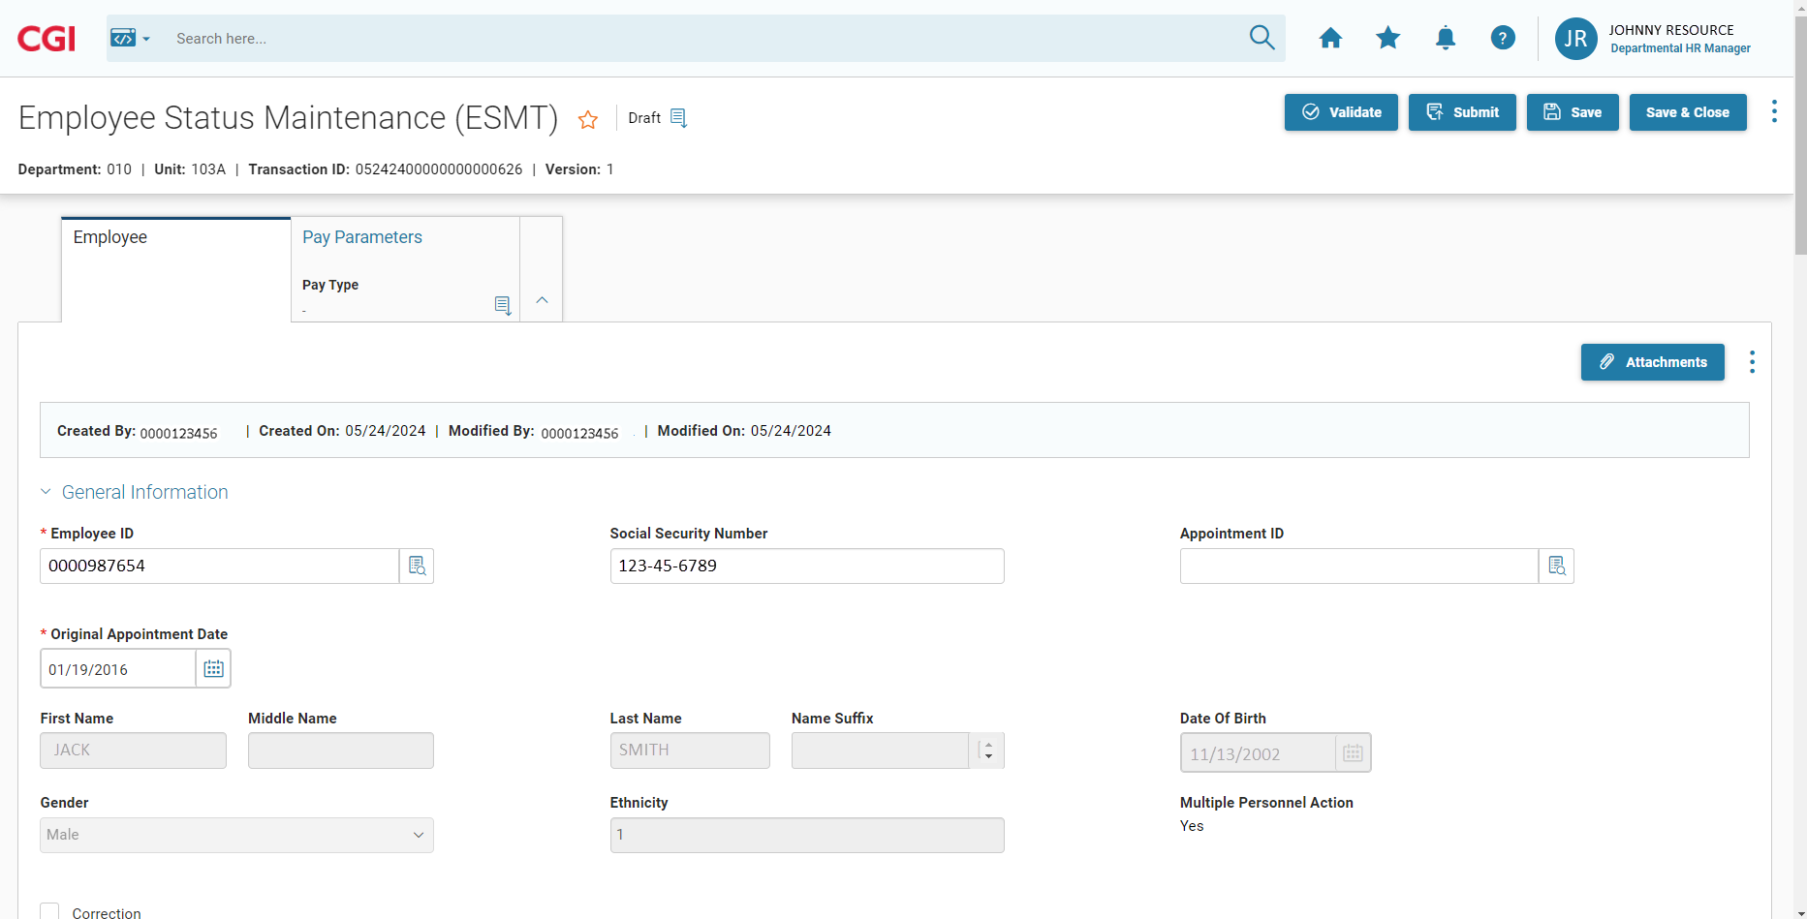
Overview
ESMT in ALHRM
Notes:
This is the ESMT screen in ALHRM. Now you have a modern screen to complete your familiar task.
Clearly defined fields
Use the scroll bar to navigate the full screen

Slide 10
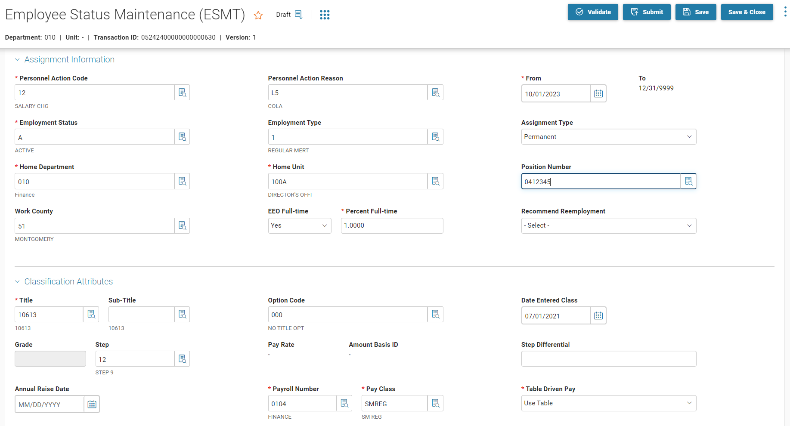
Overview
ESMT in ALHRM
Picklist
Notes:
You will now have Picklist to help you complete the fields.
Calendar fields
Buttons at the top of the page

Slide 11
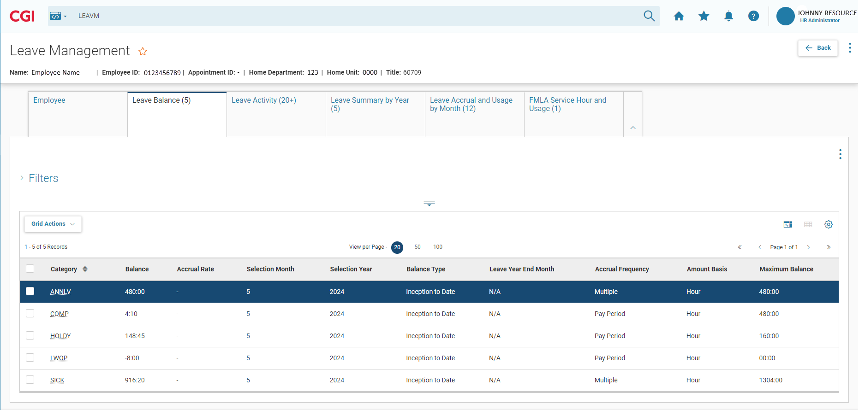
Overview
Leave Balance
Notes:
The Leave Management (LEAVM) activity folder makes it easy for you to administer leave-related information and activities by gathering all of the necessary pages together into one place.
The Leave Balance displays the leave balances for selected employee

Slide 12
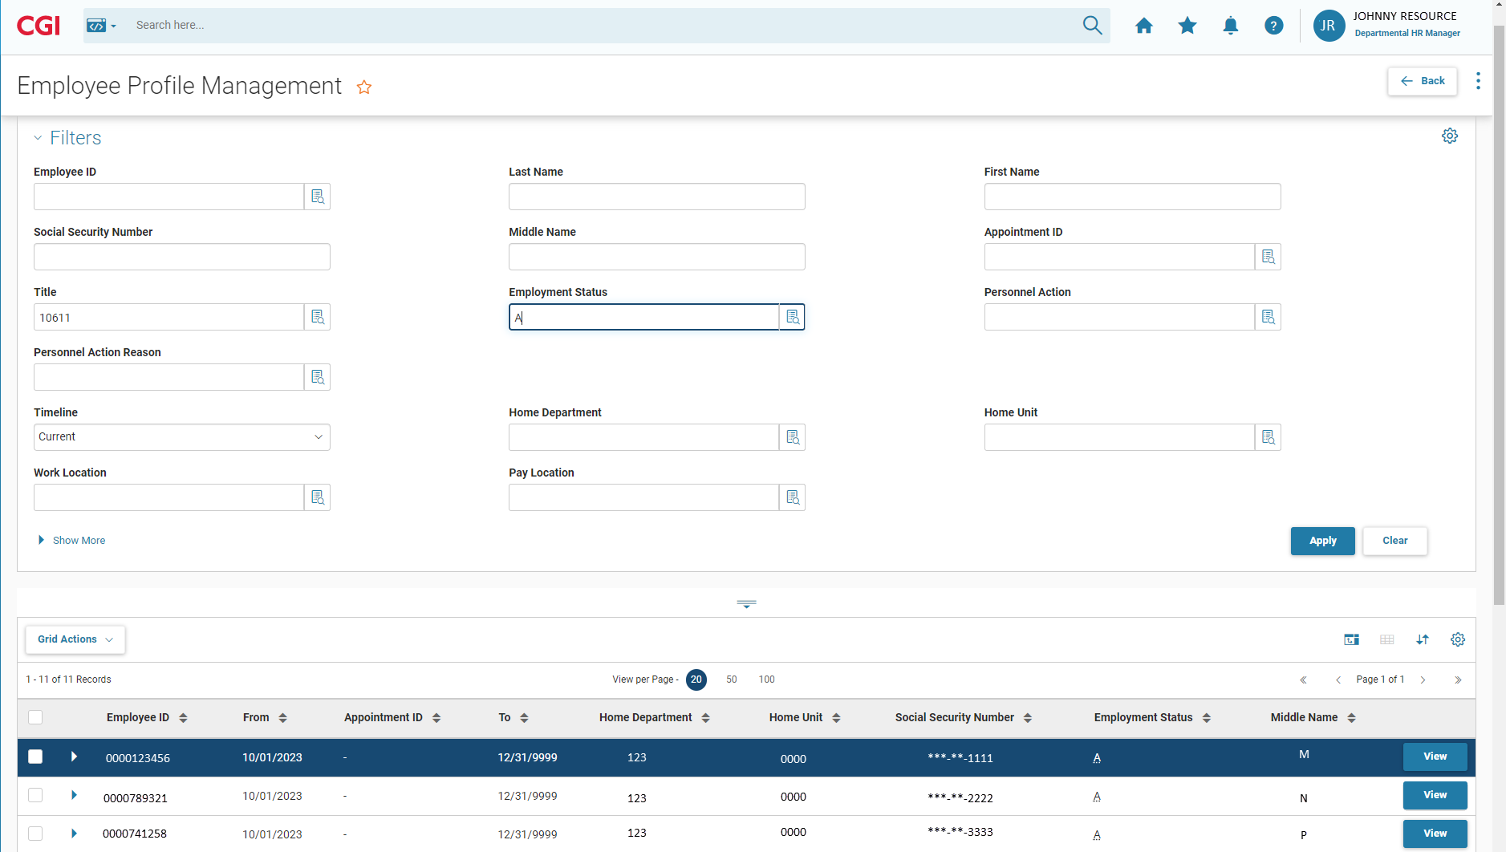
Overview
Employee Profile Management
Notes:
Use any combination of the Filters to narrow your results

Slide 13
ALHRM Rollout
We are going with an All-In-One implementation methodology allowing all agencies to go live with the new system simultaneously. The advantages of this approach are:
Less risk for data integrity and end-of-year processes such as W2s, tax filings, and report balancing
No duplication of production updates which would be required for maintaining two systems
No issues with employee transfers between agencies on different systems
We will use a two-phase rollout

Slide 14
ALHRM Rollout - Mock Parallel
The first parallel payroll will be a mock test
Agencies will key all employee updates in both GHRS and ALHRM
eSTART time and leave files will be uploaded to both systems
SPD, Comptroller, and Agencies will review both systems for payroll differences
Document lessons learned and provide appropriate resolutions

Slide 15
ALHRM Rollout – Mock Parallel
Mock Parallel Pay Periods
Semi-monthly arrears 9/1 - 9/15
Paid 10/1
Semi-monthly current 9/16 - 9/30
Paid 9/30
Monthly 9/1 - 9/30
Paid 9/30

Slide 16
ALHRM Rollout – Mock Parallel
Mock Parallel Payroll Dates
September 11 - GHRS down at 12:00p.m. (Noon) to run COLA
September 13 - GHRS online to key transactions
September 19 - ALHRM available to review employee data and key transactions
All transactions must be keyed in both GHRS and ALHRM
September 27 - GHRS and ALHRM down at 10 a.m.
State Business Systems (SBS) will provide agencies with any payroll differences for review

Slide 17
ALHRM Rollout – Go Live Parallel
The second parallel payroll will be Go Live!
Agencies will key all employee updates in both GHRS and ALHRM
eSTART time and leave files will be uploaded to both systems
SPD, Comptroller, and Agencies will review both systems for payroll differences
After payroll verification, ALHRM is live and the official system of record
GHRS will be available in view mode through March 2025

Slide 18
ALHRM Rollout – Go Live Parallel
Go Live Parallel Pay Periods
Semi-monthly arrears 10/16 - 10/31
Paid 11/15
Semi-monthly current 11/1 - 11/15
Paid 11/15

Slide 19
ALHRM Rollout – Go Live Parallel
Go Live Parallel Payroll Dates
October 29 – GHRS down at 12:00 p.m. (Noon)
October 30 - GHRS online to key transactions
November 5 - ALHRM available to review employee data and key transactions
All transactions must be keyed in both GHRS and ALHRM
November 12 - GHRS and ALHRM down at 10 a.m.
State Business Systems (SBS) will provide agencies with any payroll differences for review

Slide 20
Training
Training will begin in July
Lecture (in person)
Instructor-led hands-on training (in person)
Job Aids
Manuals
Recorded sessions
Practice environment
Users must attend training before September 19, 2024
Registration will be available on the SBS Training Registration page (https://sbsapptraining.alabama.gov)
Notes:
No worries, we will prepare you ahead of time by providing just-in-time hands-on training.
And you will have access to a wealth of Job Aids to assist you on the job.

Slide 21
Next Steps
Requests for your Agency Points of contact (POC) will be forthcoming
Questions should be directed to Agency POC
The Agency POC will contact the Personnel and Payroll Help Desk for assistance
If the Help Desk cannot resolve the issue, they will contact the correct resource (i.e. State Personnel, Comptroller, SBS) to find a solution
A link to all communications regarding implementation will be established on the SBS webpage (https://sbs.alabama.gov)
Notes:
We have your back with the Personnel and Payroll Help Desk
We are asking for a Point of Contact(s) to help streamline the call volume.

Slide 22
What Questions Do You Have?

